Slide 1
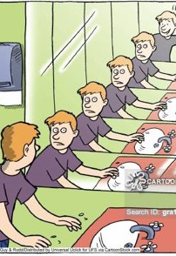

Loops
Chapter 05
while (true)
{
printf("Wash your hands.\n");
}

Slide 2

Check In
Questions? GE02 Classes, Objects, Methods, Decisions Structures
Do you need to go to office hours to get some help?
When is it due?
What must you submit?
Quiz 2 Moved to March ⅚
CS Community Circle Event Click to RSVP

Slide 3
Goals
Understand, Explain and Apply Loops
Increment and decrement operators
Different types of loops: for, while, do-while
Sentinel values and boolean flags
Scope of variables in loops
Implement the different types of loops based on situation
Exit loops correctly
Go over quiz 01

Slide 4
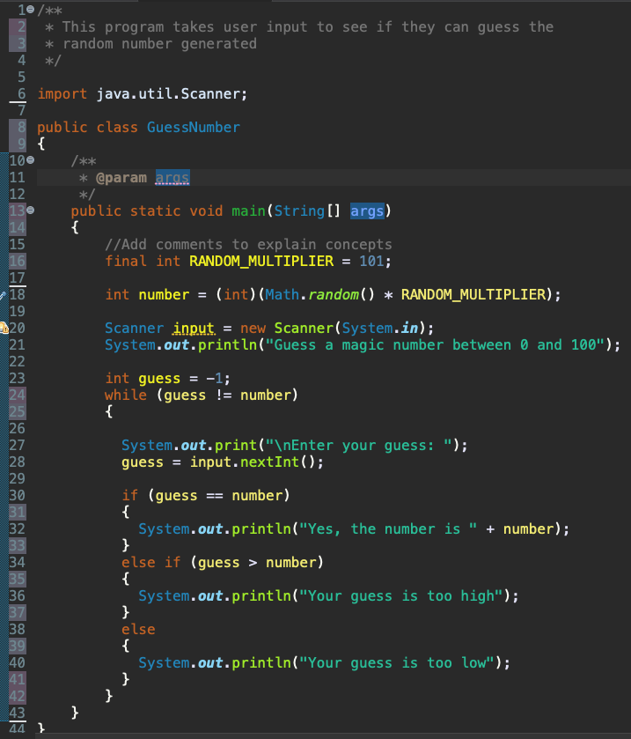


Think, write, discuss
Put your name on paper for notes.
1. Write slide 4 then put a list of words you have learned that are connected to the example on the right.
2. Rotate around each person in your group share information as you go through each line in the program.

Slide 5


Explore Increment and Decrement
Slide 5 Pretest: Write what you think will be printed out for each println.
What will be displayed?
int numDays = 100;
System.out.println (numDays);
System.out.println (++numDays);
System.out.println (numDays++);
System.out.println (numDays);

Slide 6
Increment and Decrement
int numDays = 100;
System.out.println (numDays); // Displays 100
System.out.println (++numDays); // Displays 101
System.out.println (numDays++); // Displays 101 - increments after displays
System.out.println (numDays); // Displays 102

Slide 7
Increment and Decrement Operators
Increment operators are used in programming languages to increase the value of a variable by one. There are two types of increment operators:
Prefix Increment Operator (++x):
The prefix increment operator increases the value of the variable by 1 before the value is used in the expression.
Syntax: ++x
Example: If x is initially 5, ++x will increment x to 6 and return the new value (6).
Postfix Increment Operator (x++):
The postfix increment operator increases the value of the variable by 1 after the value is used in the expression.
Syntax: x++
Example: If x is initially 5, x++ will return the current value of x (5) and then increment x to 6.

Slide 8
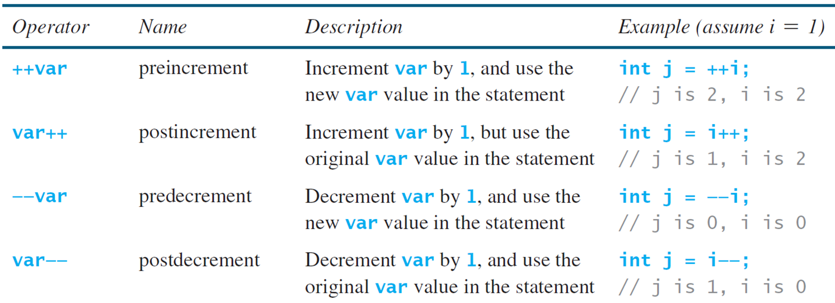
Increment and Decrement Operators
Increment ++
Decrement --

Slide 9
Postfix and Prefix
Operator can be placed before (postfix) or after (prefix) variables
Example (postfix increment/decrement)
int i = 1;
int j = 3;
i++; // Same as i = i + 1; i will become 2
j--; // Same as j = j – 1; j will become 2
Example (prefix increment/decrement)
int i = 1;
int j = 3;
++i; // Same as i = i + 1; i will become 2
--j; // Same as j = j – 1; j will become 2
Placement of operator (prefix or postfix) cause different results when in expressions so be careful!!!
Prefix increment vs Postfix increment
int x = 1;
int y = 3;
y = ++x; do increment then assignment => y becomes 2, x becomes 2
y = x++; do assignment then increment => y becomes 1, x becomes 2

Slide 10
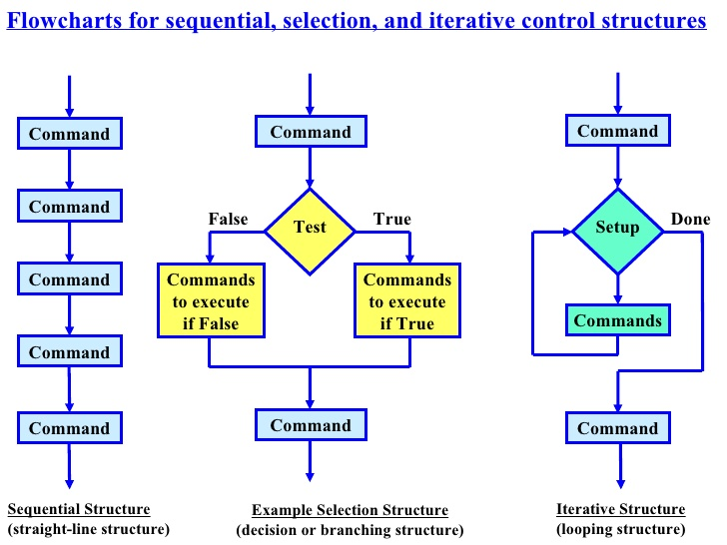
Flow of Control
The order in which statements are executed in a program

Slide 11
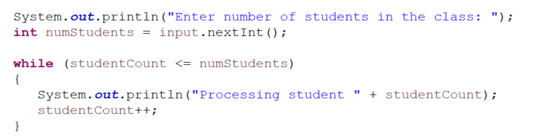
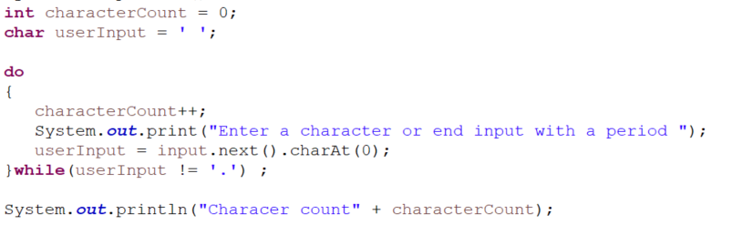
Discussion and Example Quiz Questions
Slide 11 Pretest: What is the code doing? Write the output on your paper.
Where studentcount is 0 and numStudents is 4?
What happens if the user enters the following each time the question is asked? Deb.

Slide 12
Iterative Control Structures
What if we looped until the user enters valid input?
Iterative Control Structures are used to repeat code. There three iterative structures:
While loop
Do-while loop
For loop

Slide 13
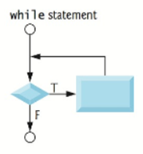
Iterative Structure: While
Iterative/Repeat control flow is used to loop until test is true.
Run the Animation to understand a while loop then go to compile the code to explore
if boolean expression is true execute body
while (boolean expression)
{
statement(s);
}
Next statement
loop body start
Indent loop body statements that will run when boolean condition is true.
MUST contain statement to change loop control
After loop body statements run go back to check if test is still true
loop body end
When the loop condition is false, run statement after loop body

Slide 14
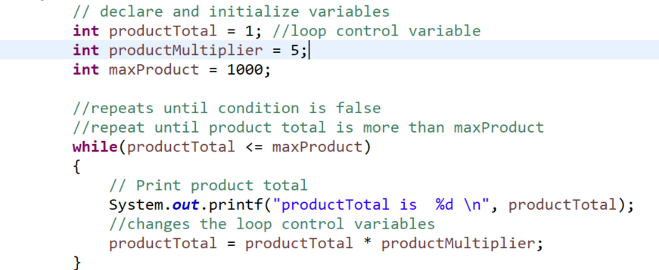
While Loop Example
Slide 14 Pretest:” What will this code do? Before trying to figure out what it will do for 1000, think about the pattern for 50, then 100

Slide 15
While Loop Example
productTotal <= maxProduct
1 <= 1000 { prodTotal = 1 *5} | T
5 <= 1000 { prodTotal = 5*5} | T
25 <= 1000 { prodTotal = 25*5} | T
125 <= 1000 { prodTotal = 125*5} | T
625 <= 1000 { prodTotal = 625*5} | T
3125 <= 1000 Exit loop | F
What will this code do?
// could also write as productTotal *= productMultiplier;
Means the same as productTotal = productTotal * productMultiplier;

Slide 16
Testing Loops: Off by One Error
Common issue with loops!
Loop body executes one more or one less than expected
Make sure your loop condition is executing the expected number of times
Example: why is this off by one?
int count = 1;
while (count < 5)
{
System.out.println(count);
count++;
}
Displays
I'm going to count to five, ready set....
1
2
3
4

Slide 17
Controlling Loop with Sentinel Value
Run animation of Sentinel Value While Loop Example
Many times, we don't know how many times a loop needs to be executed
But we may know that a certain value signifies the end of the loop
This value is called the sentinel value
Sentinel value designates the end of input. Explore Sentinel Value Java with Examples
// Read an initial data
System.out.print( "Enter an integer (the input ends if it is 0): ");
int data = input.nextInt();
// Keep reading data until the input is 0
int sum = 0;
while (data != 0) {
sum += data;
// Read the next data
System.out.print("Enter an integer (the input ends if it is 0): ");
data = input.nextInt();
}
System.out.println("The sum is " + sum);
Repeat loop until sentinel value 0 is entered.

Slide 18
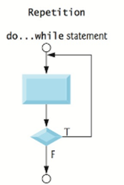
Do... While Loop
Purpose : Same purpose as a while loop, performs repeated execution (looping) but executes body of loop at least once.
General Form
do
{
statements(s);
} while (boolean expression);
loop body start
Executes body of loop at least once.
Contains statement to change loop control
Indent statements
loop body end
Checks loop condition at end. Runs again while true. Exits loop when false.
Notice this loop must end with ;
Run the animation for the do while loop

Slide 19
Do... While Loop Rules
Similar to while loop except
Executes body first then checks condition
While at end of loop and ends with ;
//Initializes the loop control variable
int counter = 1;
System.out.printf("Count before loop starts is %d ",counter);
//do while loop will execute once then check condition
do
{
//Changes the loop control variable
counter++;
System.out.printf("Count is %d \n",counter);
} while (counter <= 5); //checks condition
Count before loop starts is 1
Count is 2
Count is 3
Count is 4
Count is 5
Count is 6
Remember do while needs ;

Slide 20

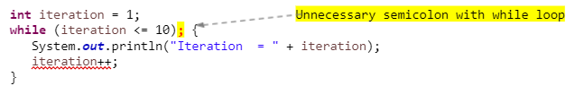
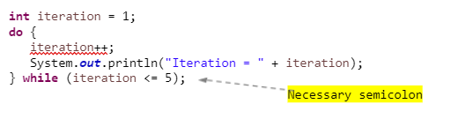
While and Do-While Loop Rules
The loop condition must be a boolean expression with relational and logical operators
Generally, some statement before the while loop "initializes" the loop condition to true
Some statement within the loop body must eventually change the condition to false
If the condition is never changed to false, the program will be forever stuck in an "infinite loop"
Curly braces are not necessary if only one statement in loop but best practice is to always include curly braces
Placing a semicolon at the end of the while-clause creates an infinite loop!
In the case of do-while you must include the semicolon since it ends the loop!
Necessary semicolon for do while

Slide 21
While Loop Design
Strategies for writing loops
1st - figure out what part of your code needs to be repeated
2nd - place that part of you code into a loop
3rd - determine what condition the loop checks
While loop condition is checked before the loop body is executed
Do - while loop condition is checked after the loop body is executed
4th - make sure you have code in the body that eventually causes the condition to become false

Slide 22
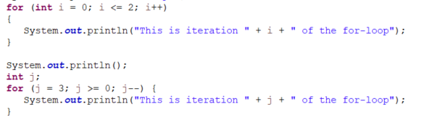
Discussion
Write down what you think this code is doing.

Slide 23
For Loop
Purpose
Same purpose as while loop => a programming structure that performs repeated execution (looping)
For loops are used to execute a loop a preset number of times
for (initialize control; test control against end value ; update control)
{
statement;
...
statement;
}
Run the animation to see how a for loop works
The control variable is initialized to a start value
The control variable is compared to the end value
If the test of the control variable evaluates to true then loop body is executed
The control variable is updated after loop body completes
Steps 2-4 are repeated as long as control test evaluates to true

Slide 24
Simple For Loop
for (int i = 0; i <= 2; i++)
{
System.out.println("This is iteration " + i + " of the for-loop");
}
For-loop is the one place in your code where variable names like "i" or "j" but there are times where better names are used
i is initialized to 0
i is compared to 2 - result is true - control enters loop body
Display => This is iteration 0 of the for-loop
i++ increments to 1
i++ is compared to 2 - result is true - control enters loop body
Display => This is iteration 1 of the for-loop
i++ increments to 2
i is compared to 2 - result is true because i <=2 - control enters loop body
Display => This is iteration 2 of the for-loop
i++ incremented to 3
i is compared to 2 - result is false - loop ends!

Slide 25
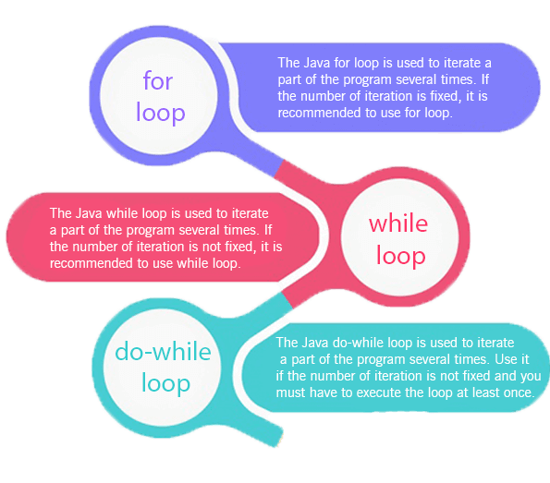
Which Loop to Use
For loop
Loops a preset number of times
Comes with built in initialization and iteration
Useful when certain how many times a loop will execute (definite loop)
While loop
Loops while some condition is true
The body of a while-loop may or may not be executed - loop can be skipped
Does not have built in initialization or iteration
Useful when unsure how many times a loop will execute (indefinite loop)
Do-while
Loops while some condition is true
The body of a do-while loop always executes once
Does not have built in initialization or iteration
Useful when unsure how many times a loop will execute (indefinite loop)
Compare:
While Loop Example
do while loop
for loop

Slide 26
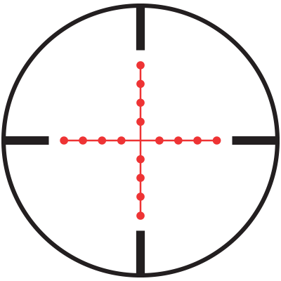
Scope
Scope - the area of a program a variable can be referenced.
for (int i = 1; i <= 5; i++) { // `i` is declared inside the loop
System.out.println("i = " + i);
}
Declaring the control variable in the for-loop causes its scope to be only inside the for loop
If I tried to use the variable j outside the for loop – causes a compiler error
Always declare control variables in for loop when control variable is only used in for loop
int i; // `i` is declared outside the loop, so it exists beyond the loop
for (i = 1; i <= 5; i++) {
System.out.println("i = " + i);
}
// ✅ `i` is accessible here because it was declared before the loop
System.out.println("Outside loop: i = " + i); // i is now 6
Declaring control variable j before the for loop cause its scope to be inside and outside for loop
This way is not needed for most cases so you will use the above example mostly.

Slide 27
Ways to Terminate (exit) For Loops
For loops terminate after a certain amount based on preset amount. This can be
System.out.println("Countdown begins!");
// Start from 10 and count down to 0
for (int i = 10; i >= 0; i--) {
System.out.println("Countdown: " + i);
}
System.out.println("Blast off!");
System.out.println("Counting by 2s!");
// Start at 0 and increment by 2 up to 20
for (int i = 0; i <= 20; i += 2) {
System.out.println("Count: " + i);
}
System.out.println("Done!");
System.out.println("Counting up!");
// Start at 1 and count up to 10
for (int i = 1; i <= 10; i++) {
System.out.println("Count: " + i);
}
System.out.println("Done!");

Slide 28
Ways to Terminate (exit) Loops
There are different ways to terminate while loops based on the problem you are trying to solve.
do {
System.out.println("Hello! Would you like to continue? (yes/no): ");
// Convert to lowercase for consistency
response = input.nextLine().toLowerCase();
} while (response.equals("yes")); // Loop continues while response is "yes"
Ask a question
System.out.print("Enter a number (-1 to stop): ");
number = input.nextInt(); // Read the first number
while (number != -1) { // Loop runs until the user enters -1
System.out.println("You entered: " + number); // Ask for the next number System.out.print("Enter a number (-1 to stop): ");
number = input.nextInt();
}
Test for a particular value (sentential value)
System.out.print("How many times should I print a message? ");
int times = input.nextInt();
int count = 0;
while (count < times) { // Loop runs for the number of times specified
System.out.println("This is message #" + (count + 1));
count++; // Increment counter
}
The user decides how many times the loop will run.

Slide 29
🚫 Bad: Equality Test of Floats
Do not perform equality checking with floating point numbers in the loop control
Floating point numbers are an approximation
Checking for equality could lead to inaccurate results
In this example, there is no guarantee that item will ever be zero – it most likely is an infinite loop
double item = 1;
double value = 0;
while (item != 0)
{
value = value + item;
item = item - 0.1;
System.out.println("Item = " + item);
}
Item = 0.9
Item = 0.8
Item = 0.7000000000000001
Item = 0.6000000000000001
Item = 0.5000000000000001
Item = 0.40000000000000013
Item = 0.30000000000000016
Item = 0.20000000000000015
Item = 0.10000000000000014
Item = 1.3877787807814457E-16
Item = -0.09999999999999987
Item = -0.19999999999999987
Item = -0.2999999999999999
Item = -0.3999999999999999
Item = -0.4999999999999999
Item = -0.5999999999999999
Item = -0.6999999999999998
Item = -0.7999999999999998
Item = -0.8999999999999998
Item = -0.9999999999999998
Item = -1.0999999999999999
Values are starting to get off
Now we are off enough to miss 0 on next iteration

Slide 30

Use int in loop conditions
Notice what can happen when you use doubles in condition
double sum = 0;
// See what happens when use double as loop control variable
// Adding 0.01, 0.02, 0.03, ... 0.99, 1 to sum (100 numbers)
for (double k = 0.01; k <= 1.0; k = k + 0.01)
{
sum = sum + k;
}
System.out.println("Sum should be 50.50 - and we got - " + sum);
Displays => Sum should be 50.50 - and we got - 49.50000000000003
double sum = 0;
double currentValue = 0.01;
// See what happens when use int as loop control variable
// Adding 0.01, 0.02, 0.03, ... 0.99, 1 to sum (100 numbers)
for (int k = 1; k <= 100; k++)
{
sum = sum + currentValue;
currentValue = currentValue + 0.01;
}
System.out.println("Sum should be 50.50 - and we got - " + sum);
Instead use ints

Slide 31

🚫 BAD: Using Infinite Loop
Be careful when the test is always true. This creates an infinite loop where only the statements in the while block will run over and over and over …
while (true)
{
printf("Wash your hands.\n");
}
count = 1; // Initializes the loop control variable
while (count <= 4) {
System.out.println("The value of count is " + count);
}
This is an infinite loop because (count <= 4) will always be true
Nothing changes the value of count in the loop body
If you accidentally create infinite loop, use terminate button (red square) to make it stop!
Placing a semicolon at the end of the while-clause creates an infinite loop - be careful! You do not want to create infinite loops.
int iteration = 1;
while (iteration <= 10);
{
System.out.println("Iteration = " + iteration);
iteration++;
}

Slide 32
🚫 BAD: Using break to Exit Early (Avoid)
❌ Bad Example (Using infinite loop and using break to Exit a Loop)
while (true) { // Infinite loop
System.out.print("Enter a positive number: ");
num = input.nextInt();
if (num > 0) {
System.out.println("You entered: " + num);
break; // Unstructured exit from loop
}
System.out.println("Invalid input. Try again.");
}
Do not make infinite loop and instead make a condition that can be true or false.
A break statement forces the loop to stop immediately, which is not good for structured programming.
⚠ Why This is Bad
Breaks loop flow early instead of using a clear loop condition.
Makes the logic harder to follow.

Slide 33
❌ Bad Example Using System.exit(0)
for (int i = 1; i <= 5; i++) { // ✅ Ensures the loop will run at most 5 times
System.out.print("Enter a number: ");
int number = input.nextInt();
if (number == 0) {
System.out.println("Exiting program...");
System.exit(0); // 🚨 BAD: Ends the program abruptly instead of finishing naturally
}
System.out.println("You entered: " + number);
}
⚠ Why This is Still BAD
❌ Program ends abruptly if 0 is entered, instead of finishing the loop naturally. ❌ Prevents final cleanup code from running, meaning any necessary post-loop logic never executes. ❌ Does not allow for proper error handling or expansion, making the code harder to maintain.

Slide 34
🔥 Summary: Proper Ways to Exit a Loop
When is an Infinite Loop Useful?
Useful in:
Event-driven programming (e.g., game loops).
Server processes that wait for user input or network requests.
Embedded systems where programs should not terminate.
Best Practices to Avoid Unintentional Infinite Loops:
Ensure loop conditions eventually become false.
❌ Bad Approach | ✅ Better Approach
Using break unnecessarily | Use a proper loop condition
Using System.exit(0) | Let the loop end naturally
Using continue unnecessarily | Use if-else instead
Creating an infinite loop | Ensure loop condition is correct

Slide 35
Quiz 01 and Course Grades
Quiz 1 Solutions
Quiz 1 | A | B | C | D | F | Didn’t Take
Sec 003 | 3 High 49/50 | 4 | 5 | 4 | 4 | 1
Sec 004 | 10 High 49/50 | 4 | 5 | 3 | 5 | 4
Total | 13 | 7 | 10 | 7 | 9 | 5
Course | A | B | C | D | F | Didn’t Count
Sec 003 | 6 High 98 | 6 | 2 | 5 | 1 | 1
Sec 004 | 9 High 99 | 4 | 3 | 3 | 8 | 4
Total | 15 | 9 | 5 | 8 | 9 | 5

Slide 36
Preparation
Go to canvas and open class participation questions. Use paper to help you answer question 1.
Then work on GE02 or practice creating loops.
Practice: What will the loop print out?
After class make a for loop, a while loop and a do while to run 5 times.
int count = 1;
while (count < 5)
{
System.out.println(count);
count++;
}

